Slide 1
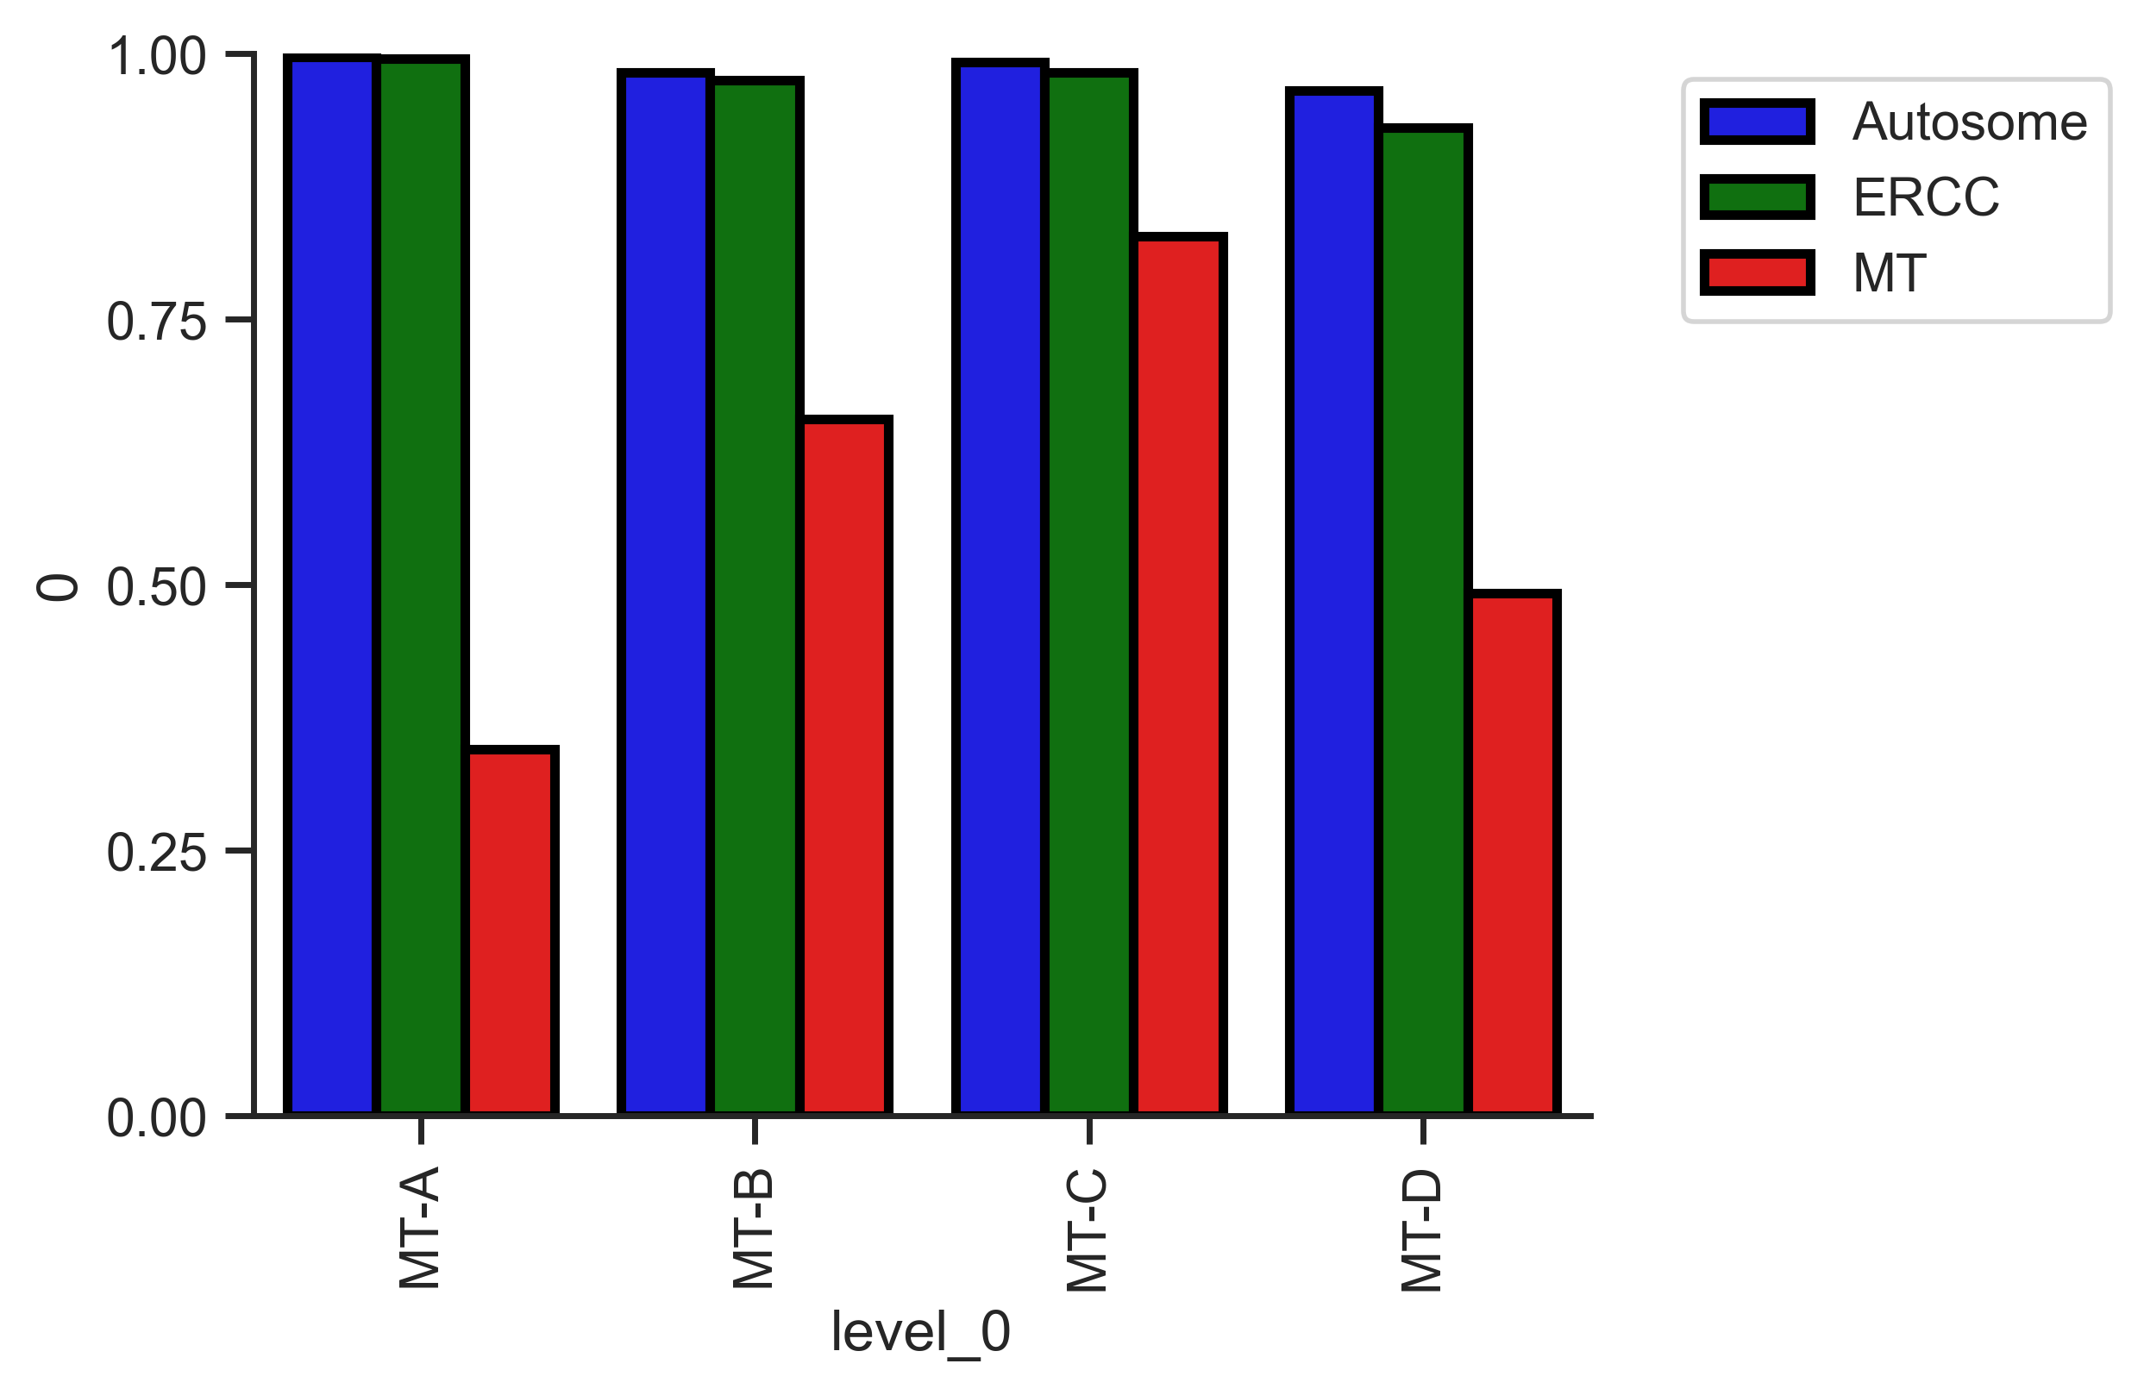
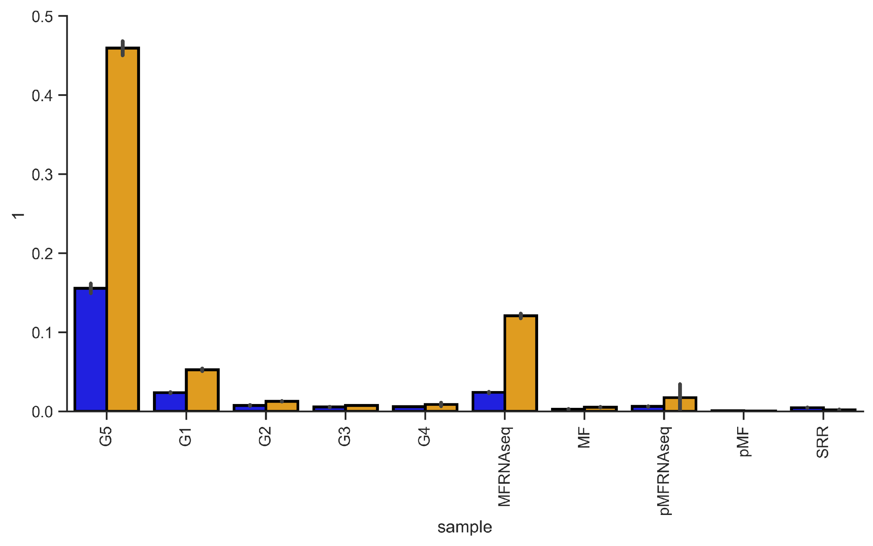
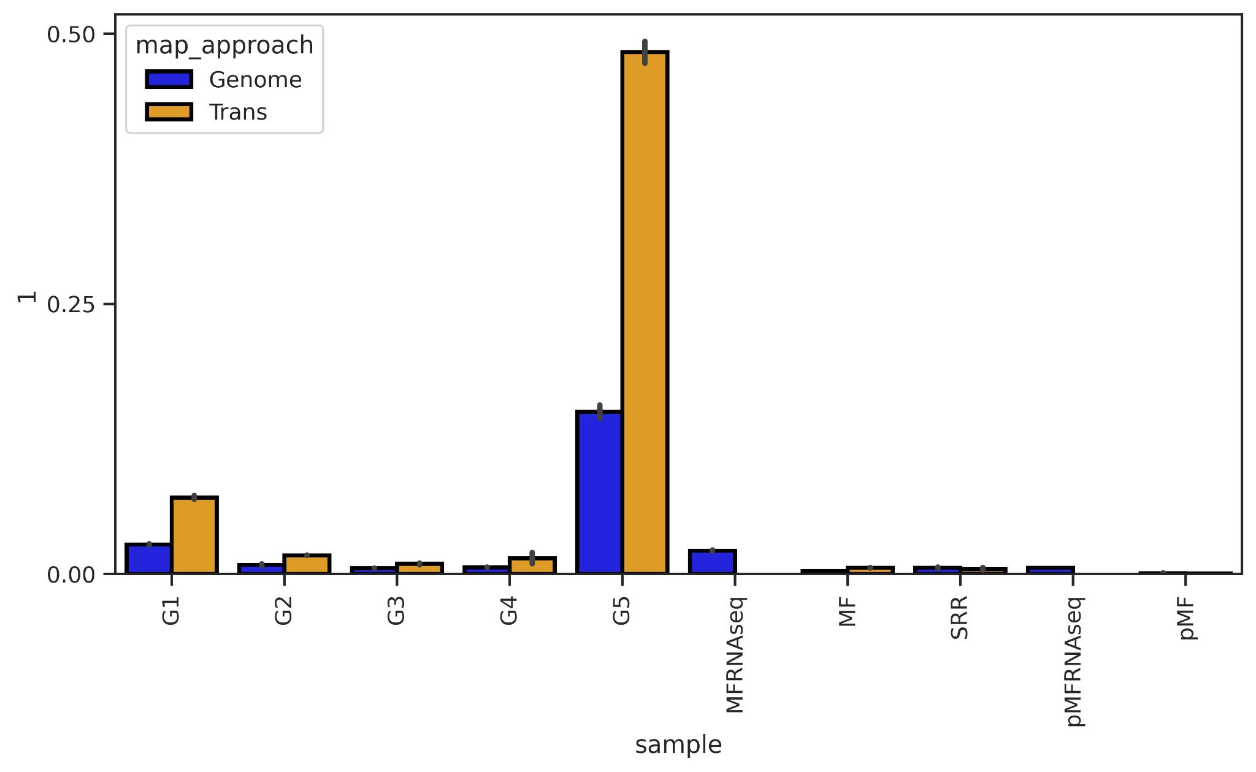
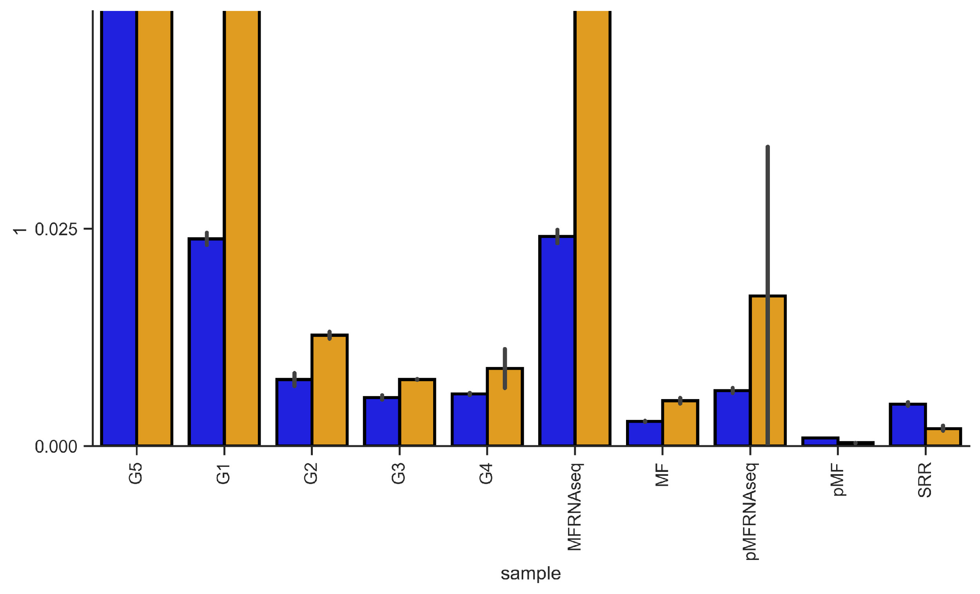
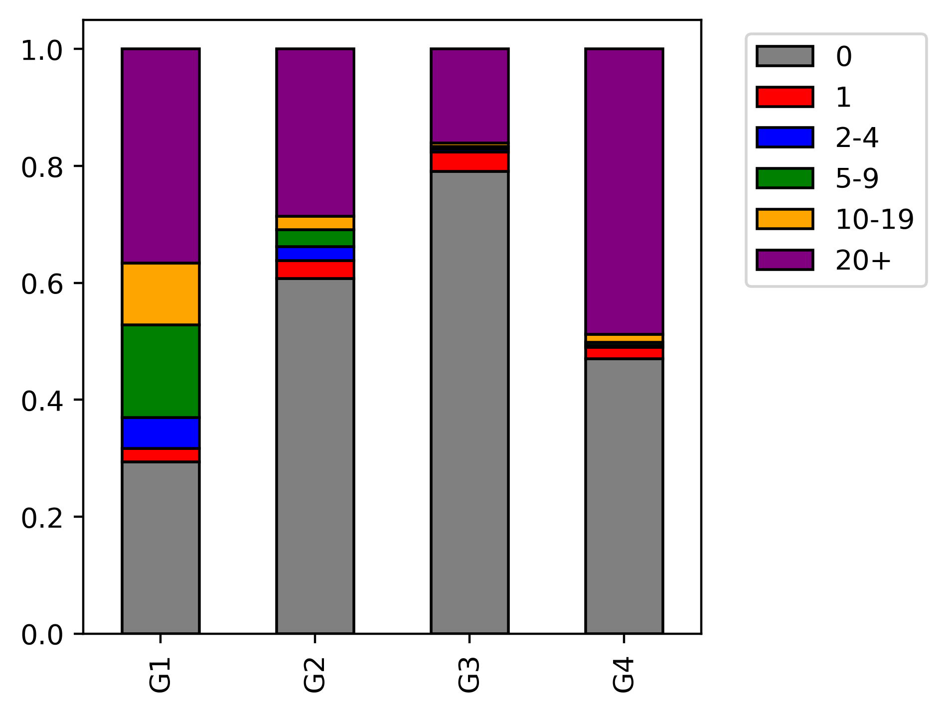
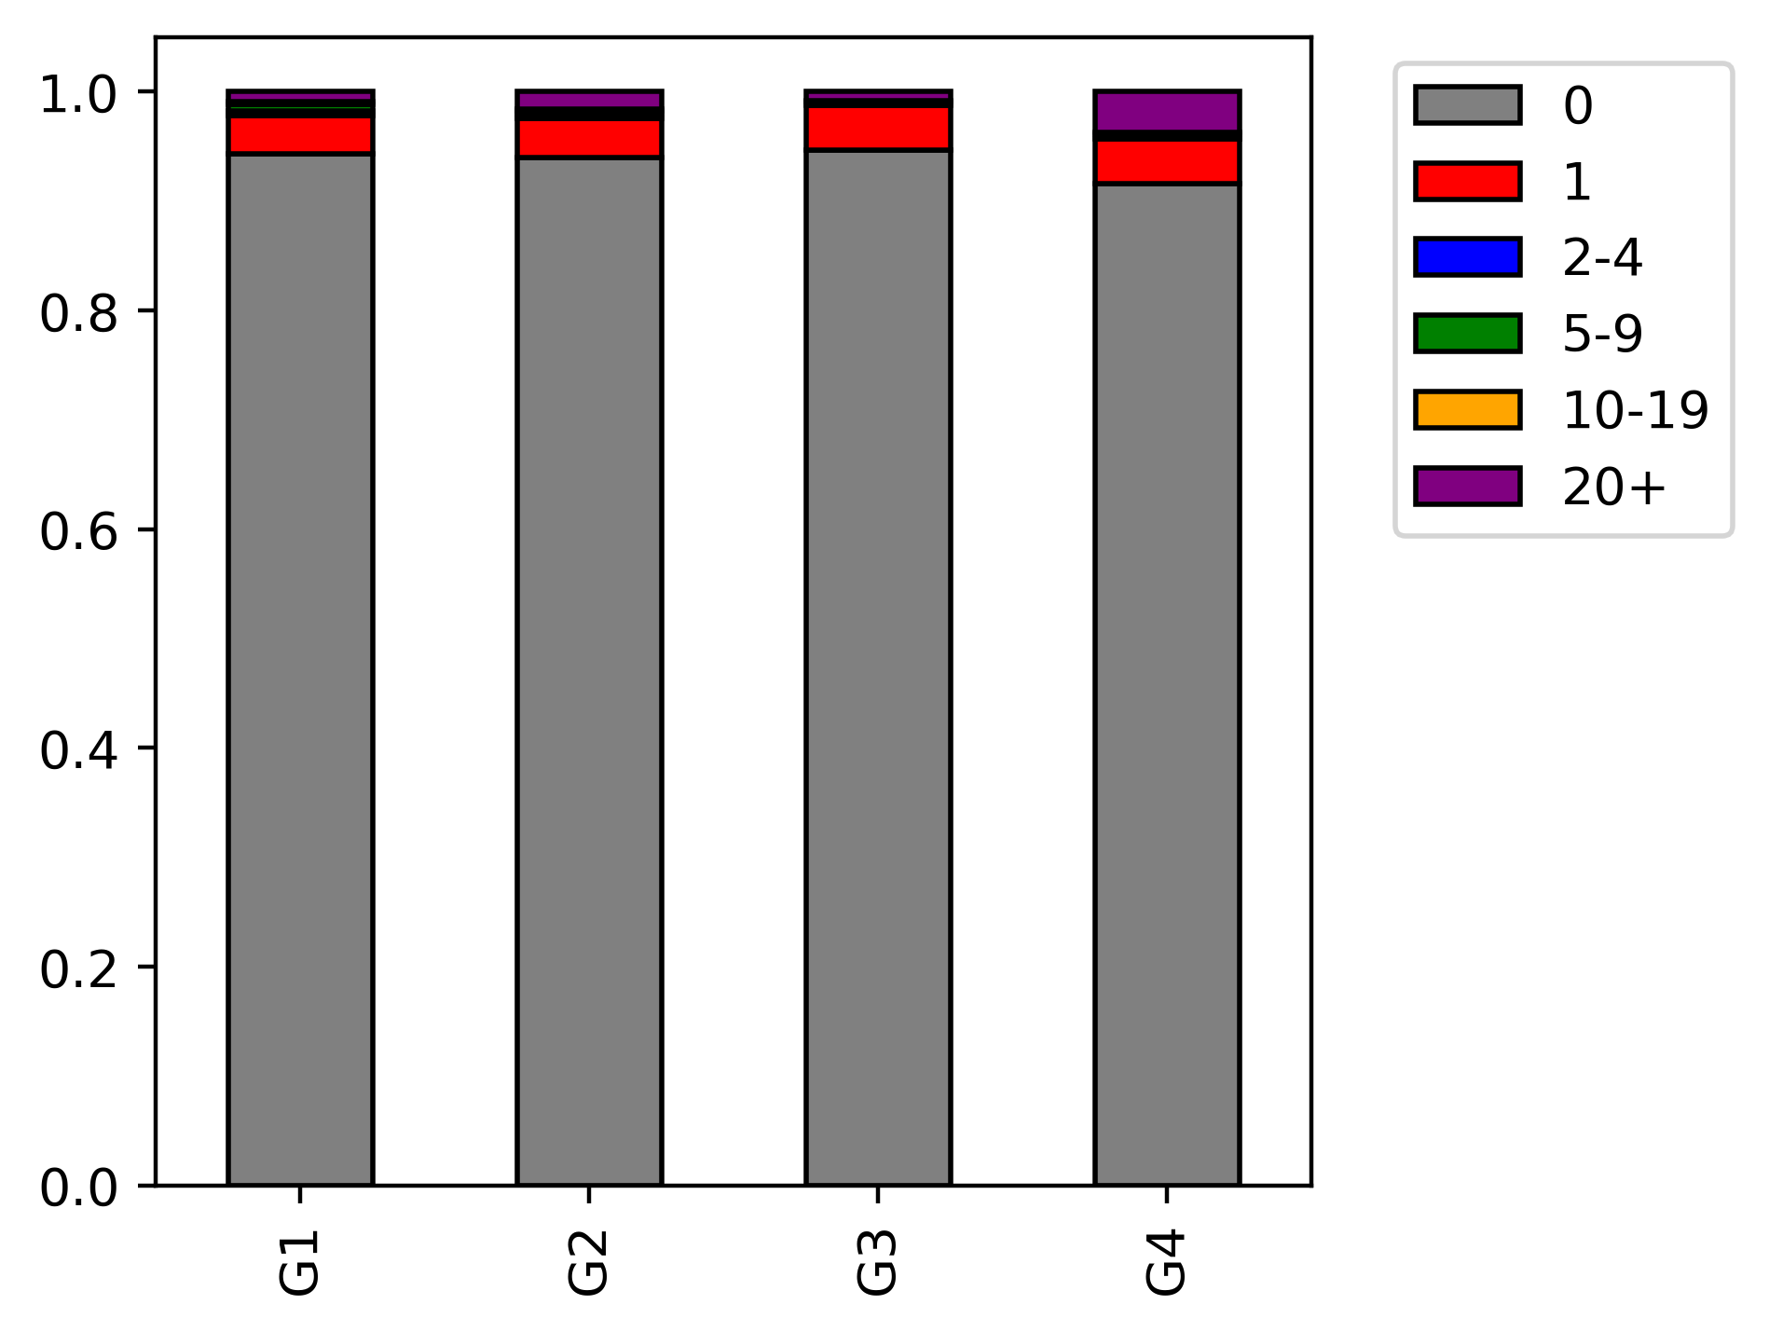
Non-mitochondrial
D
E
ERCC
Mitochondrial
50%
30%
10%
2.5%
0%
meRanGh (Genome)
meRanT (Transcriptome)
Mitochondrial chromosome
mapped reads
Retained reads after 3C filter
MT-A
MT-A
MT-B
MT-C
MT-D
MT-B
MT-C
MT-D
MT RNAseq
Total RNAseq
Poly RNAseq
Total RNA BS-seq
Huang
Poly RNA BS-seq
F
Mitochondrial mapped reads
Non-mitochondrial mapped reads
Proportion of reads
Proportion of reads containing p-m5C
MT-A
MT-B
MT-C
MT-D
MT-A
MT-B
MT-C
MT-D

